Slide 1
MEMO WRITING

Slide 2
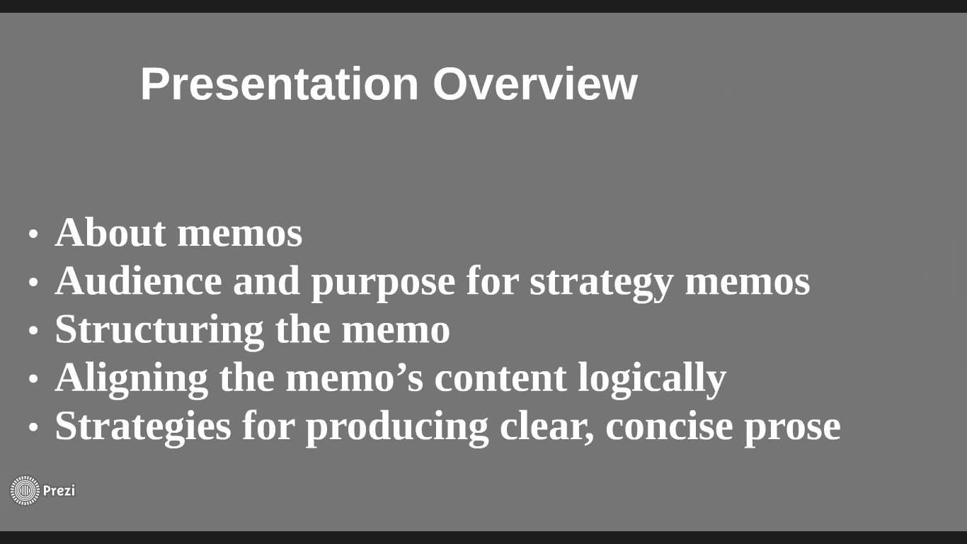

Slide 3
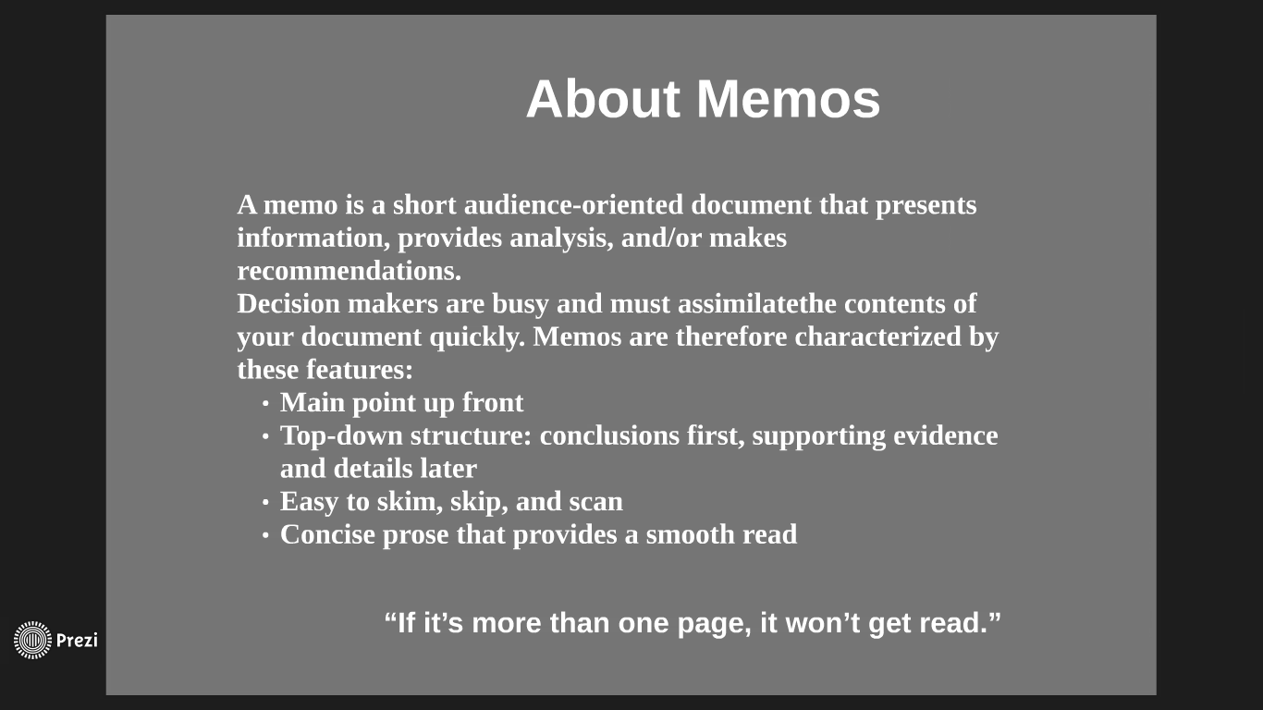

Slide 4
a.k.a. “Memorandum” or “Internal Letter”
A written communication between the employees and/ or employer within the same company
Characteristics
Brief
Concise
Lacks salutations
For skimming only
Not more than a page (as much as possible)
Uses
To designate responsibility
To communicate the same material to many people
To inform people of policy and procedure
To confirm oral agreements or decisions
To place specific information on record

Slide 5


Slide 6
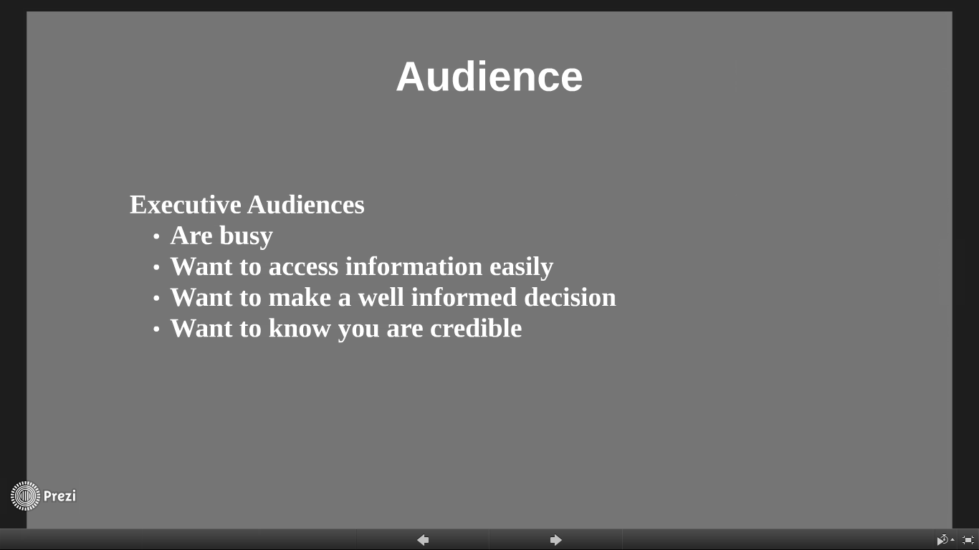

Slide 7
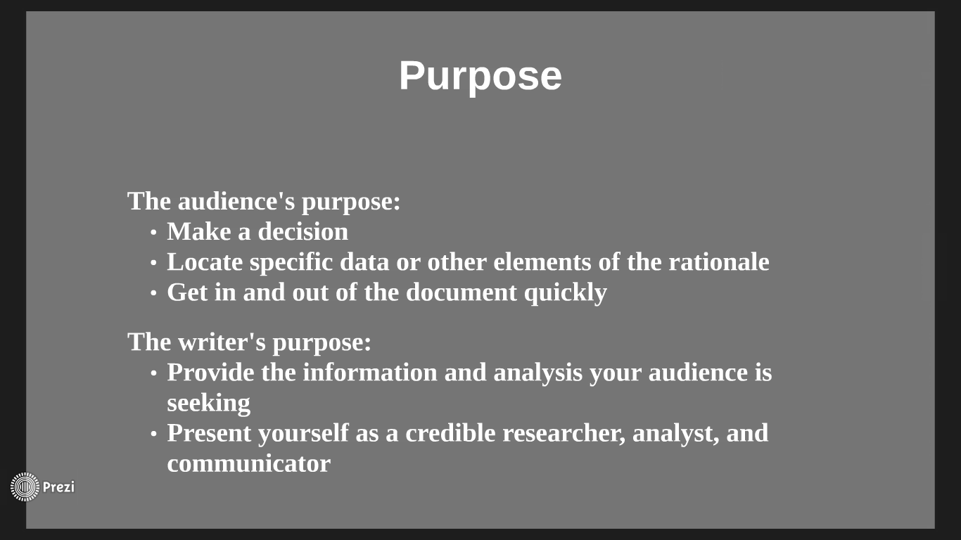

Slide 8
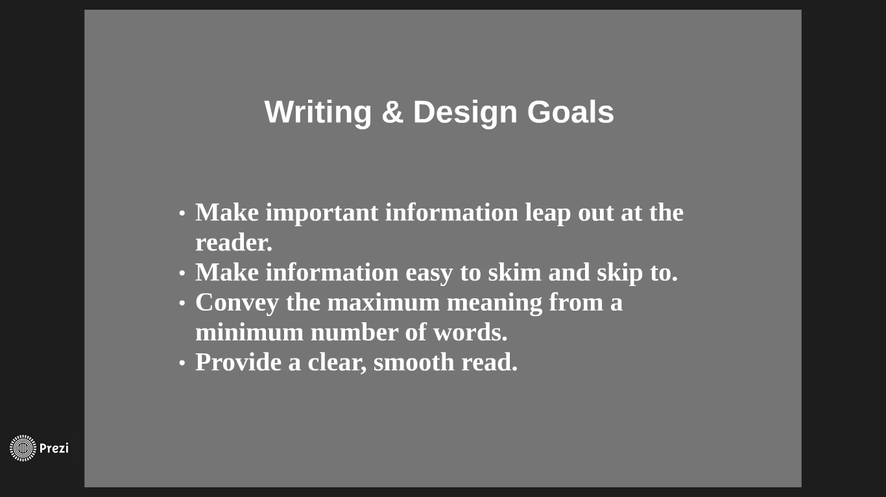

Slide 9
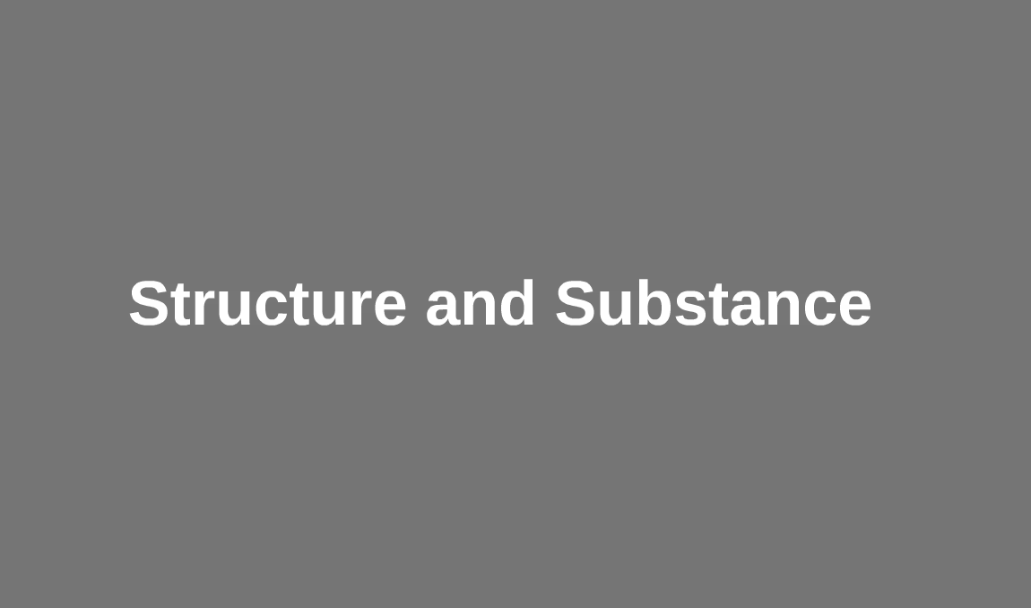

Slide 10
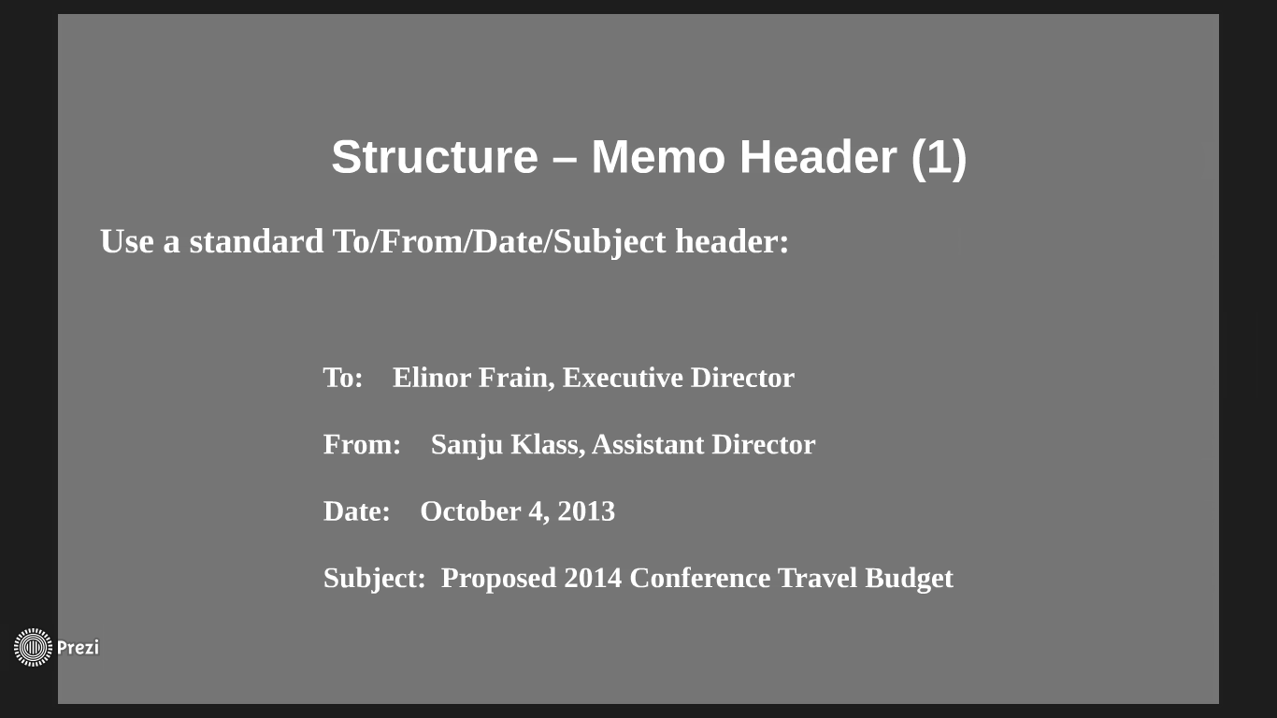

Slide 11
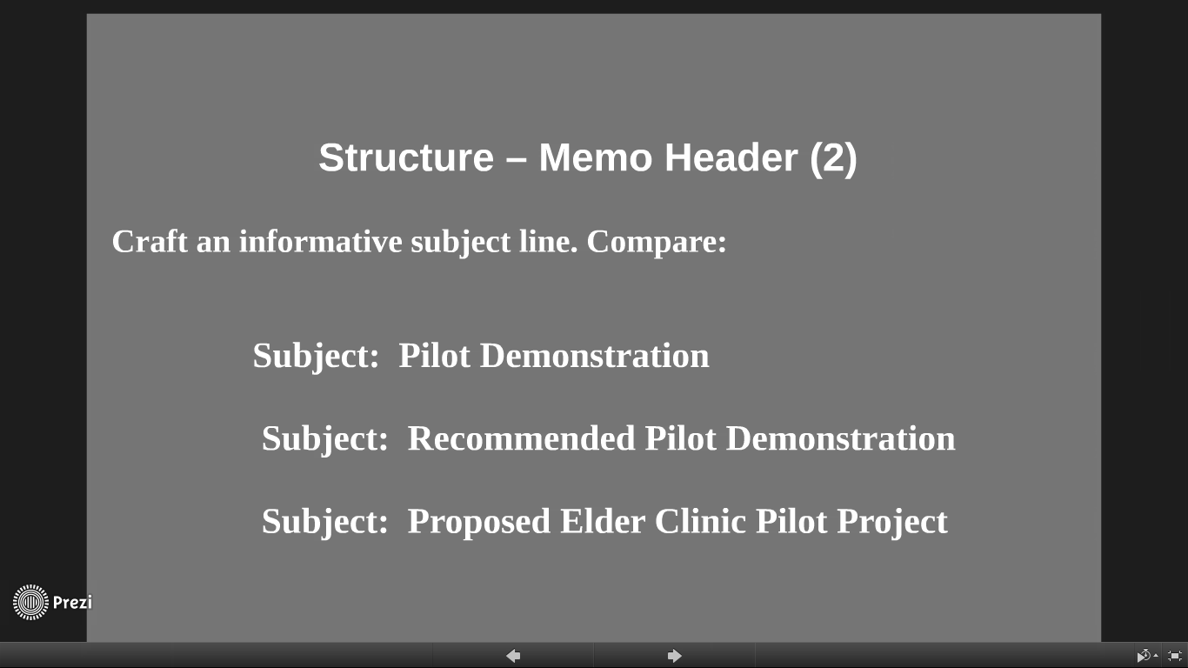

Slide 12
BODY
- All information that support the ideas
- Discuss the problem or issue
OPENING
Includes:
Date Recipient
Writer Subject
ARGUMENTS
- Explains the relevance of facts
- Includes strong points and evidence
CLOSING
- State the desired outcome or
- Action to be taken by the reader

Slide 13
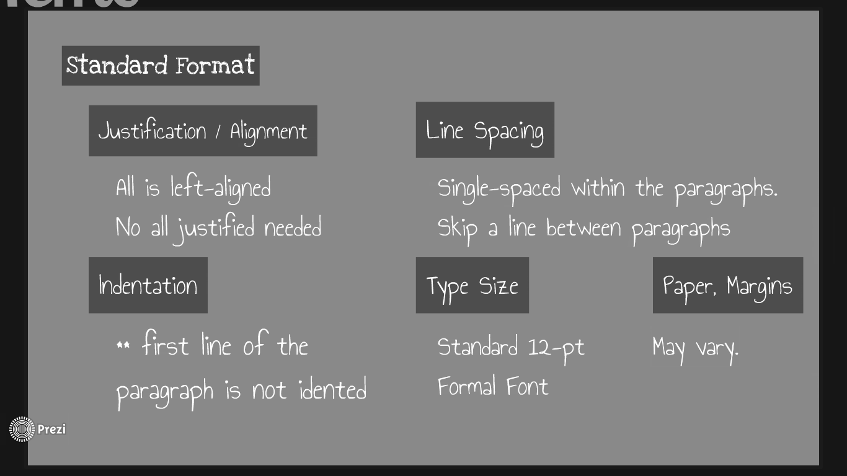

Slide 14
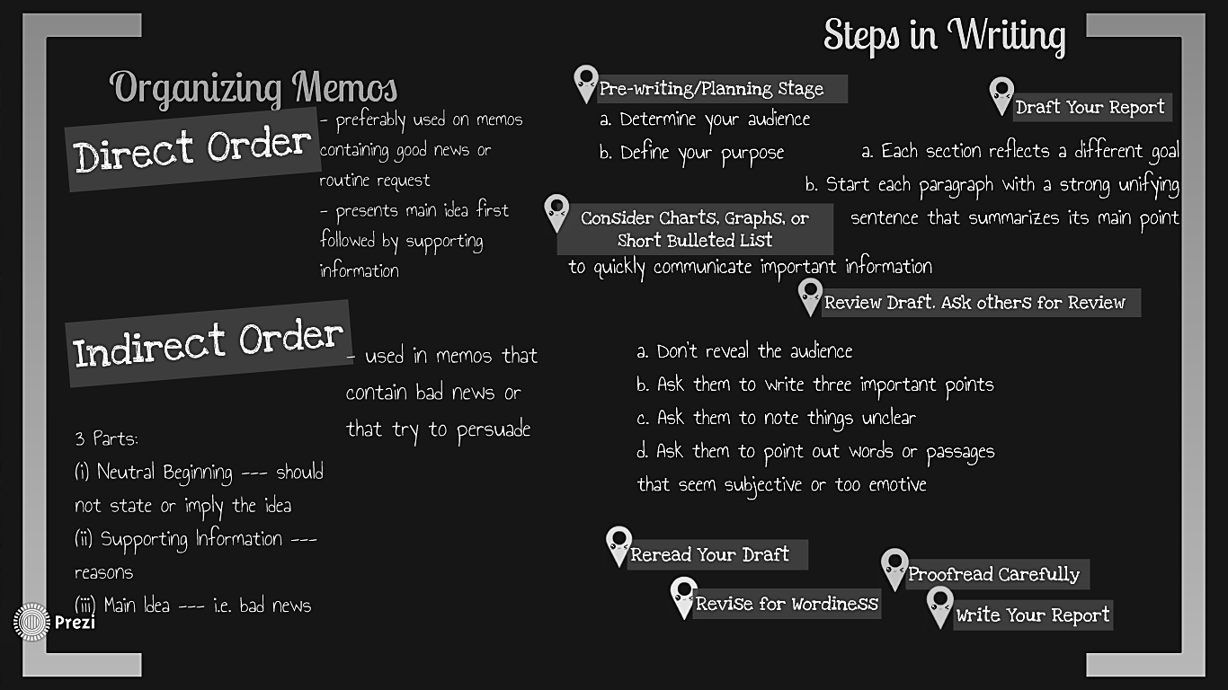

Slide 15
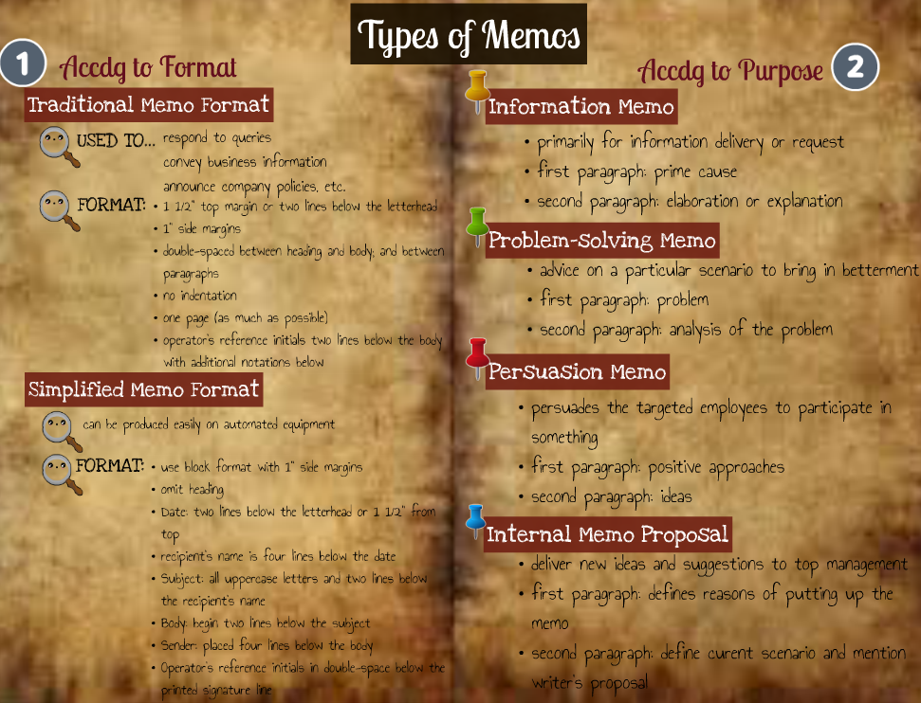

Slide 16
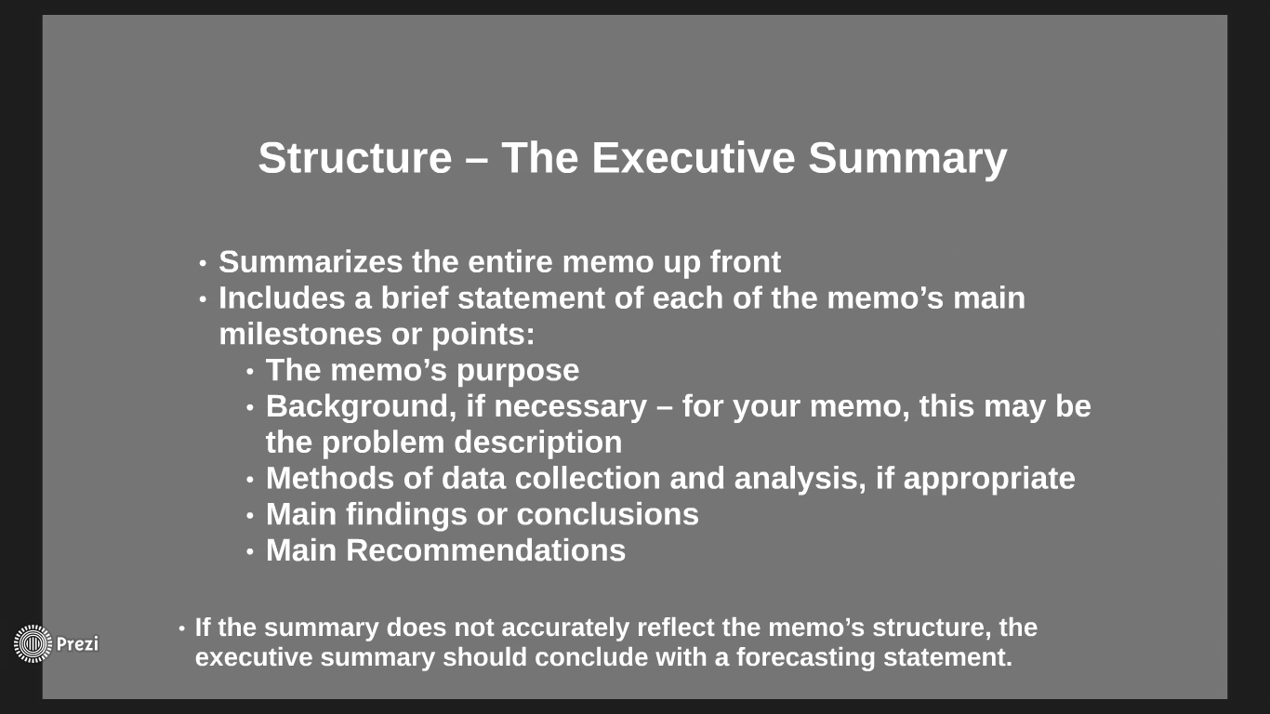

Slide 17
